Slide 1

Library Database Analysis

Slide 2
About me :
Background :
I am Sandhya L, a graduate in Computer Science and Business Systems from GITAM University, Bangalore (2025) . My academic journey has provided me with a strong foundation in computer science concepts along with an understanding of business systems.
Why you want to learn Data Science ?
I grew interested in Data Science Through my internships and projects, I understood the value of data-driven insights in addressing intricate problems. As I gained experience using technologies such as Python, SQL, and cloud computing, which revealed to me how data could be used for predictive analysis and decision-making, I became interested in Data Science. I am interested in creating expertise in analytics, artificial intelligence, and real-time data solutions.

Slide 3
Any work experience :
I have gained practical experience through internships and projects. At CodSoft, I worked on Python programming, automation. Later, during my Intel internship, I contributed to developing a Tele-ICU monitoring system that focused on real-time patient monitoring and automated event detection. I have also worked on academic projects such as Data Leakage Prevention using Cloud Computing and a Drug Recommendation System using Machine Learning.
Share your LinkedIn and GitHub profile URLs :
You can connect with me on LinkedIn at linkedin.com/in/sandhya-l-2ab1062a1 and explore my work on GitHub at https://github.com/Sandhya269

Slide 4
Objective of the Project :
The objective of the project Library Database Analysis is to design and analyze a structured library database using SQL to efficiently manage and retrieve information about books, authors, members, and transactions. It aims to demonstrate how SQL can be applied to organize data, perform queries, and generate meaningful insights such as book availability, borrowing trends, and member activity. This project focuses on improving data accessibility, accuracy, and decision-making for library management.

Slide 5
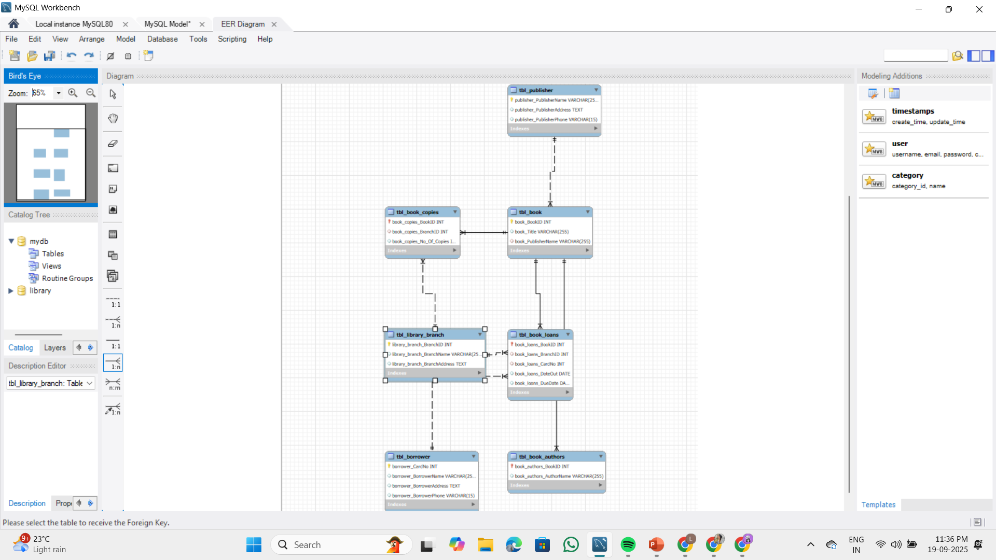
ER Diagram and schema explanation :

Slide 6
This ER diagram represents a Library Management System that manages books, publishers, authors, library branches, borrowers, and book loans.
Publisher (tbl_publisher): Stores publisher details like name, address, and phone.
Book (tbl_book): Stores book details such as BookID, Title, and Publisher.
Author (tbl_book_authors): Stores author names linked to each book.
Library Branch (tbl_library_branch): Stores branch details like BranchID, Name, and Address.
Book Copies (tbl_book_copies): Records number of copies of each book available in a branch.
Borrower (tbl_borrower): Stores borrower information such as CardID, Name, Address, and Phone.
Book Loans (tbl_book_loans): Records details of books borrowed, branch, borrower, and loan dates.

Slide 7
Key analysis questions (use cases)
Find how many copies of “The Lost Tribe” are in the Sharpstown branch.
Find how many copies of “The Lost Tribe” are in each branch.
List all borrowers who have no books checked out.
From Sharpstown branch, list books due on 2/3/18 with borrower’s name and address.
For each branch, show branch name and total books loaned out.
List borrowers with more than 5 books checked out (with their names and addresses).
For books by Stephen King, show titles and number of copies in the Central branch.

Slide 8
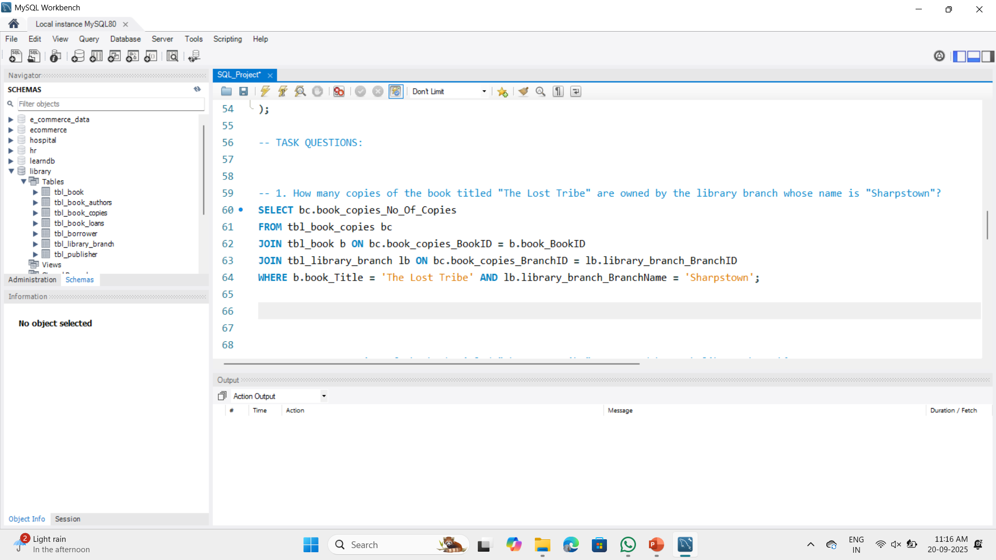
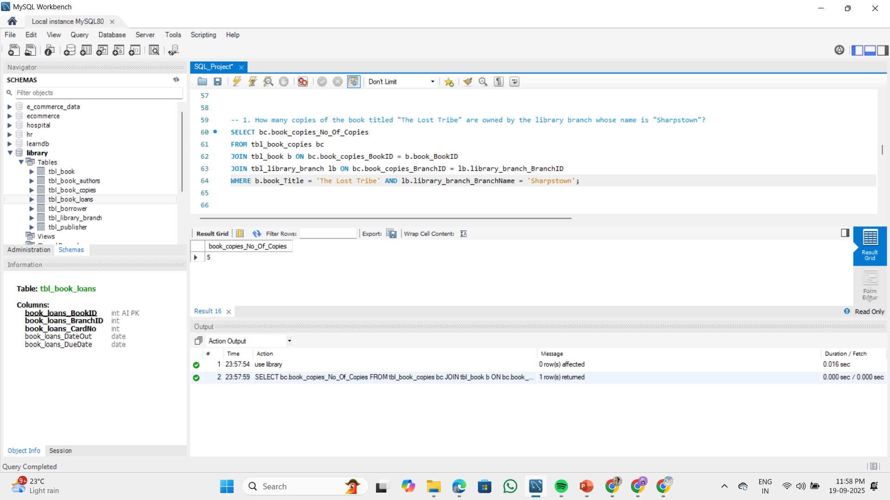
SQL query results with screenshots or summaries
1.How many copies of the book titled "The Lost Tribe" are owned by the library branch whose name is "Sharpstown"?
Result : 5 copies, the Sharpstown branch owns 5 copies of the book "The Lost Tribe".

Slide 9
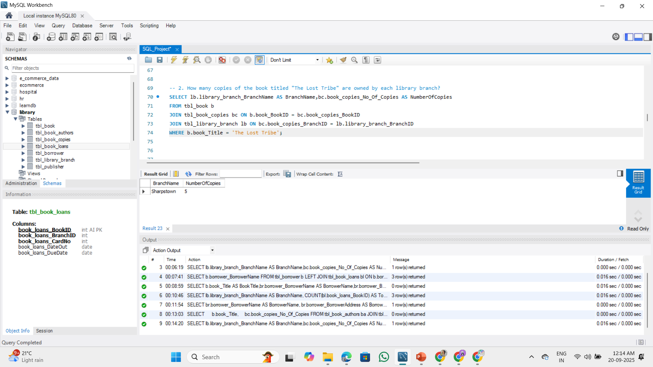
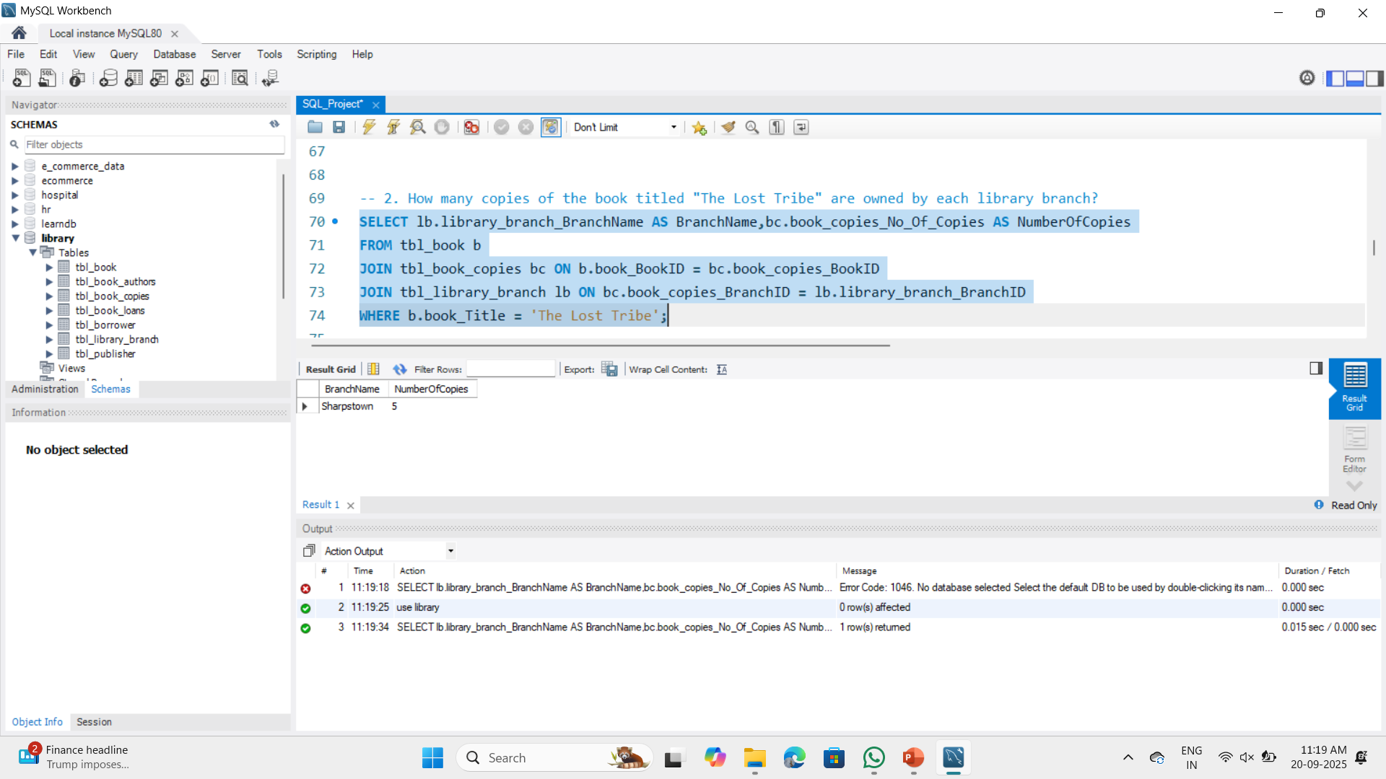
2. How many copies of the book titled "The Lost Tribe" are owned by each library branch?
Result: 5 copies, the Sharpstown branch owns 5 copies of the book in each library branch.

Slide 10
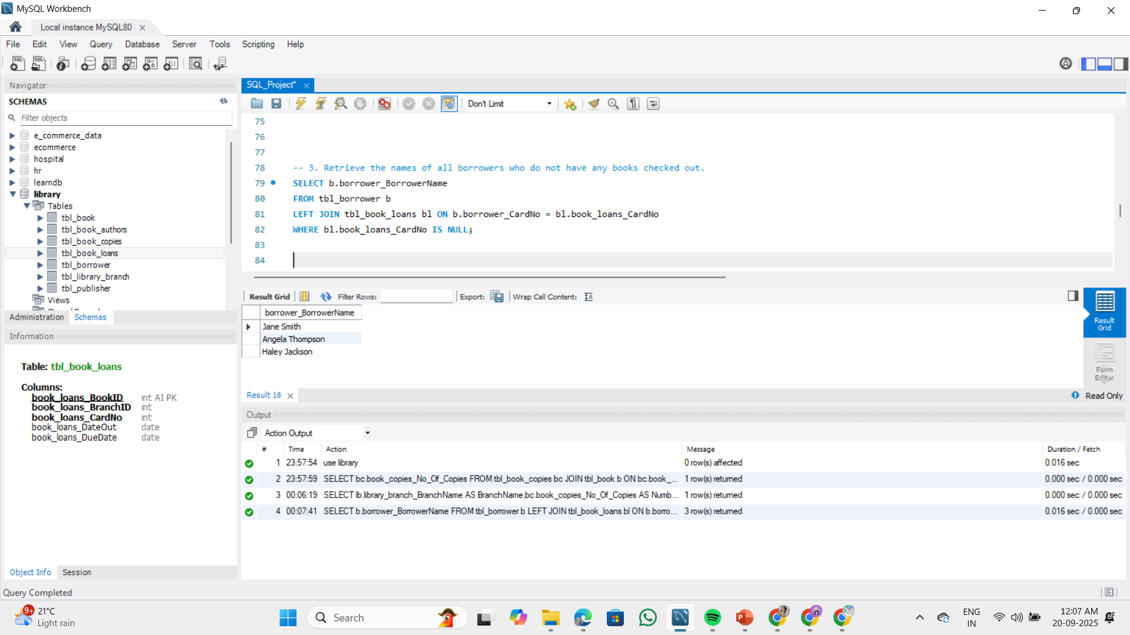
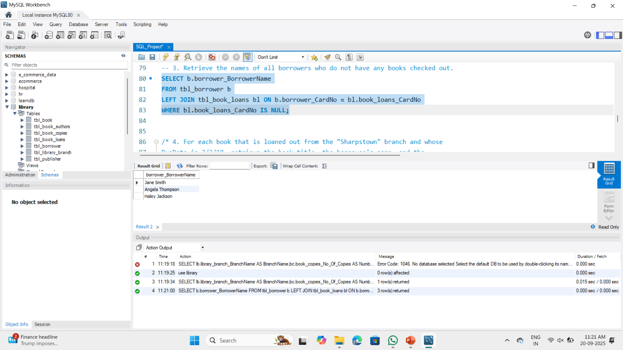
3. Retrieve the names of all borrowers who do not have any books checked out.
Result: Three borrowers(3) - James Smith, Mary Johnson, and Patricia Jackson - who do not have any books checked out currently.

Slide 11
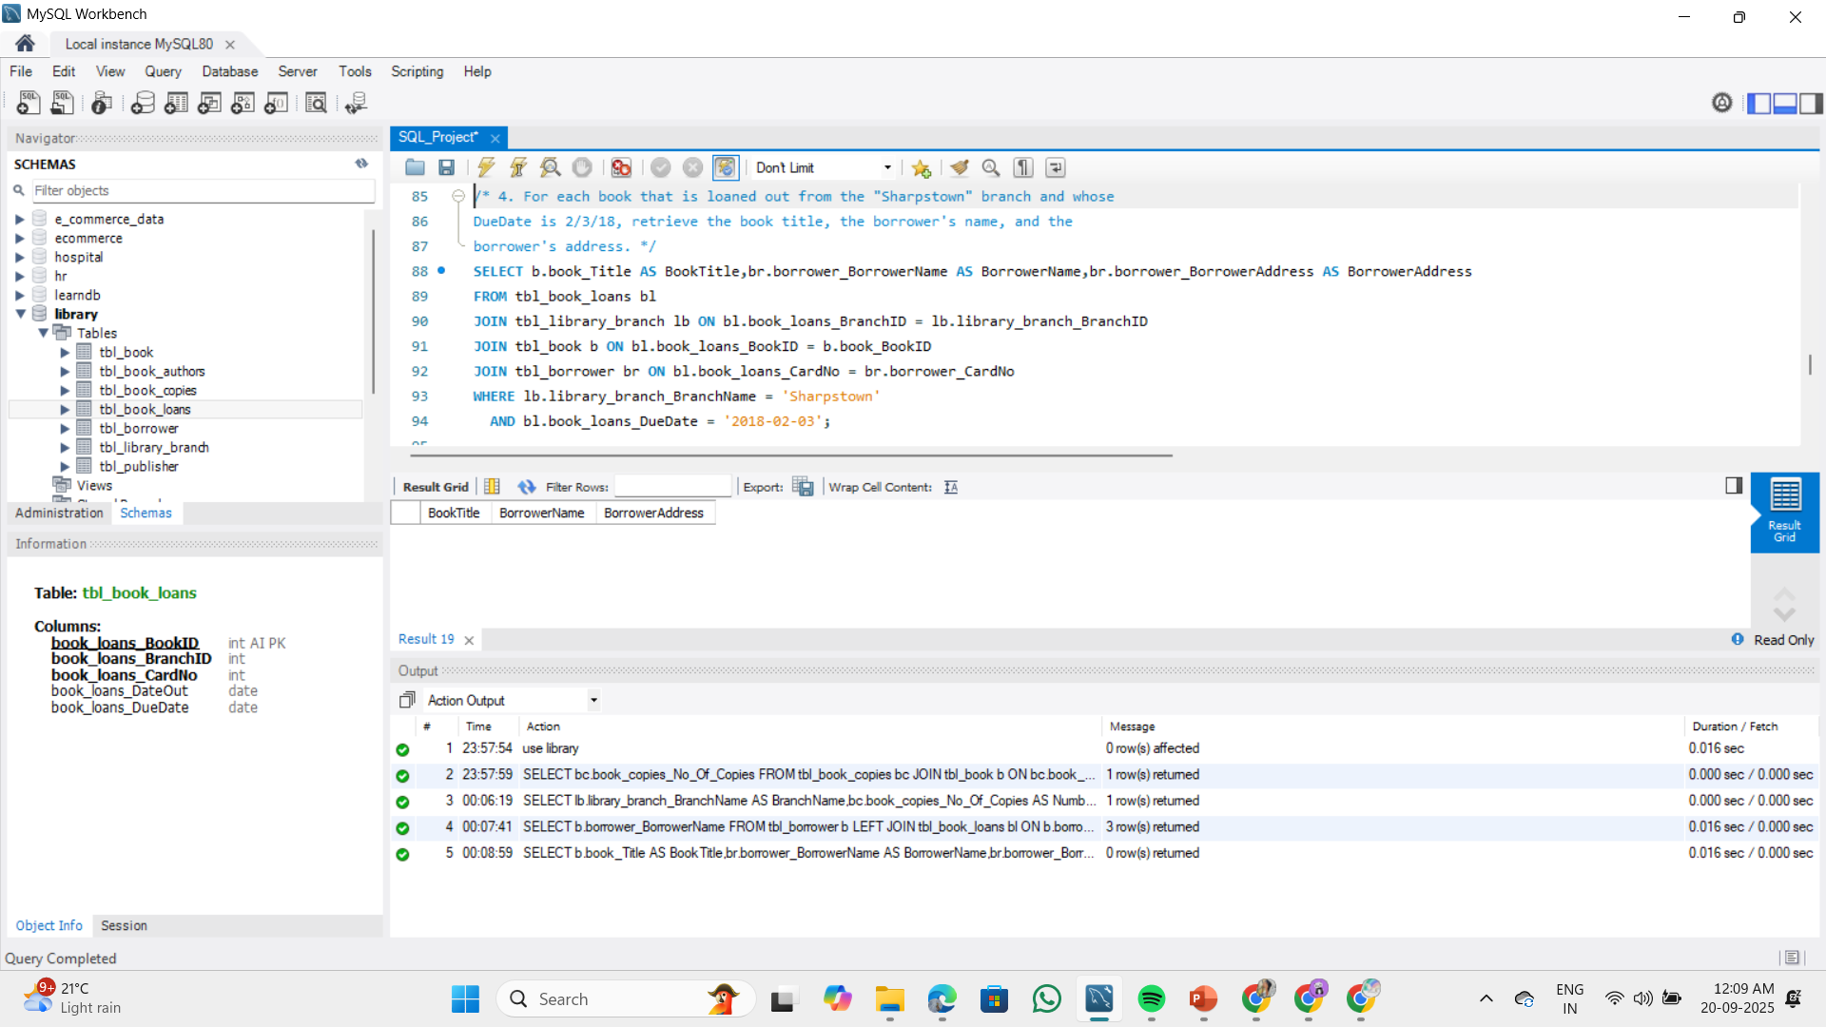
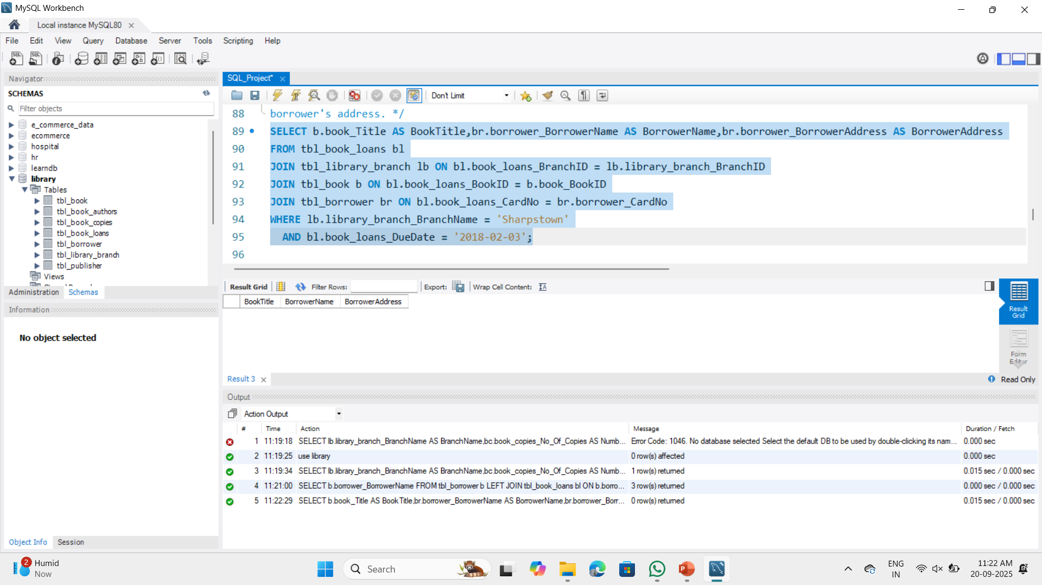
4. For each book that is loaned out from the "Sharpstown" branch and whose DueDate is 2/3/18, retrieve the book title, the borrower's name, and the borrower's address.
Result:

Slide 12
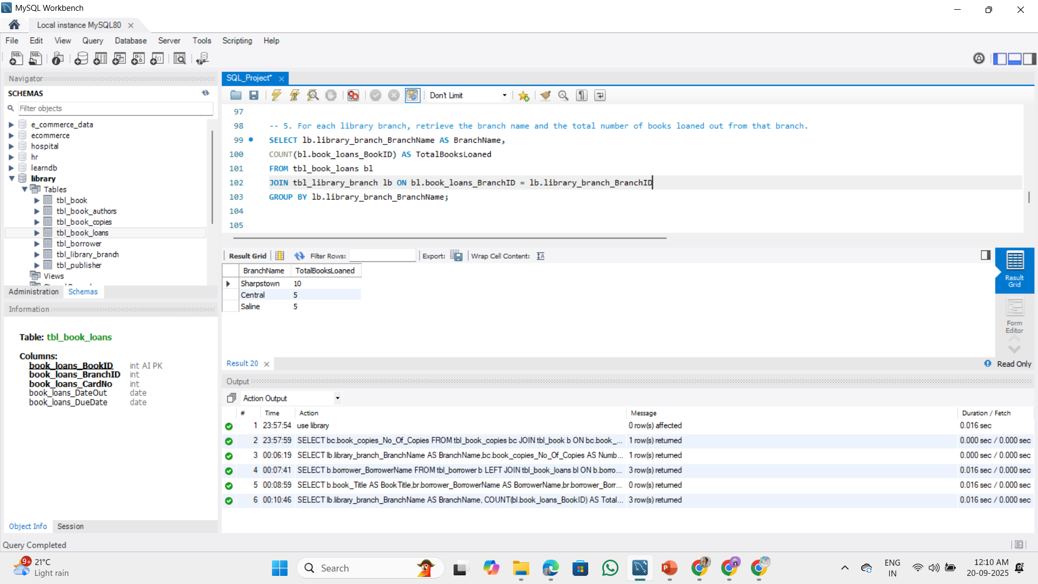
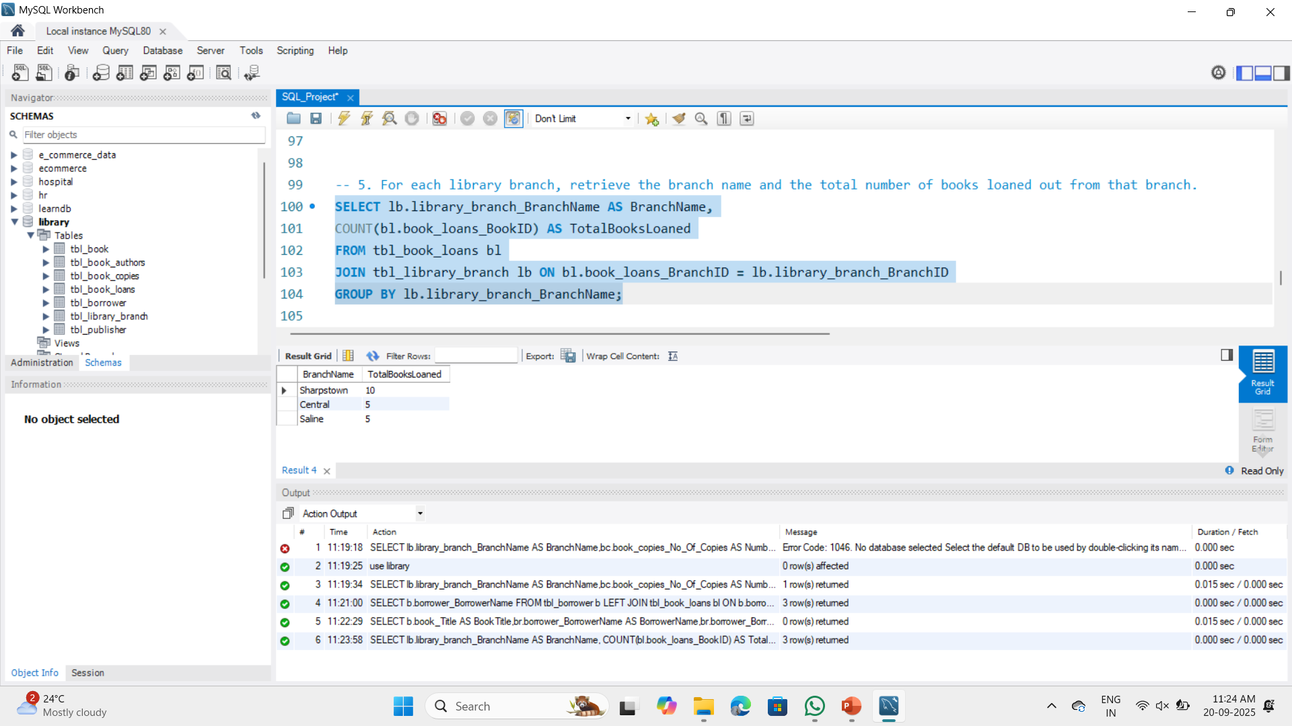
5. For each library branch, retrieve the branch name and the total number of books loaned out from that branch.
Result: Sharpstown branch loaned out 10 books. Central branch loaned out 5 books. Saline branch loaned out 5 books.

Slide 13
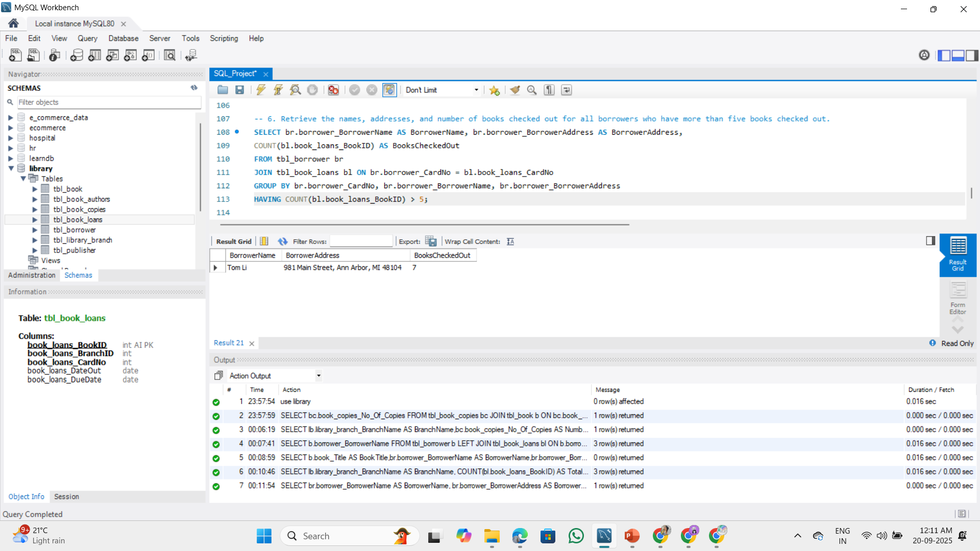
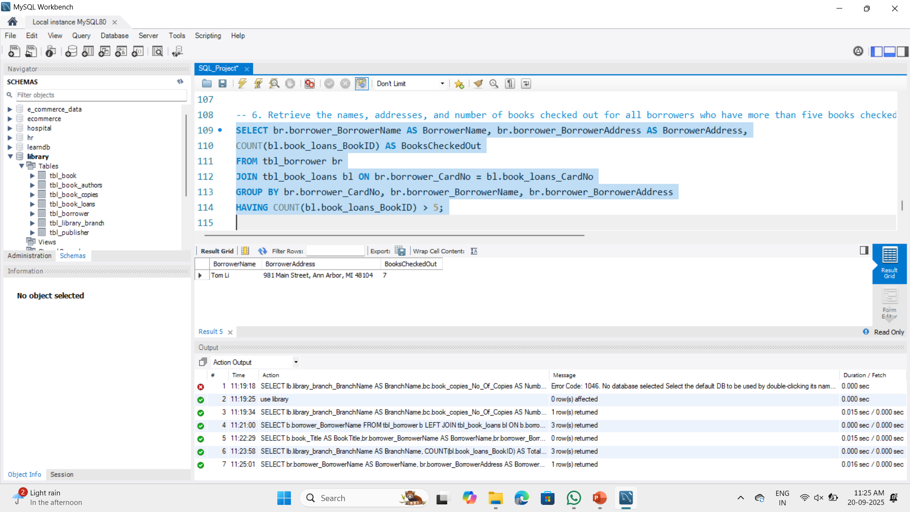
6. Retrieve the names, addresses, and number of books checked out for all borrowers who have more than five books checked out.
Result: Tom Li, living at 981 Main Street, Ann Arbor, MI 48104, has checked out 7 books.

Slide 14
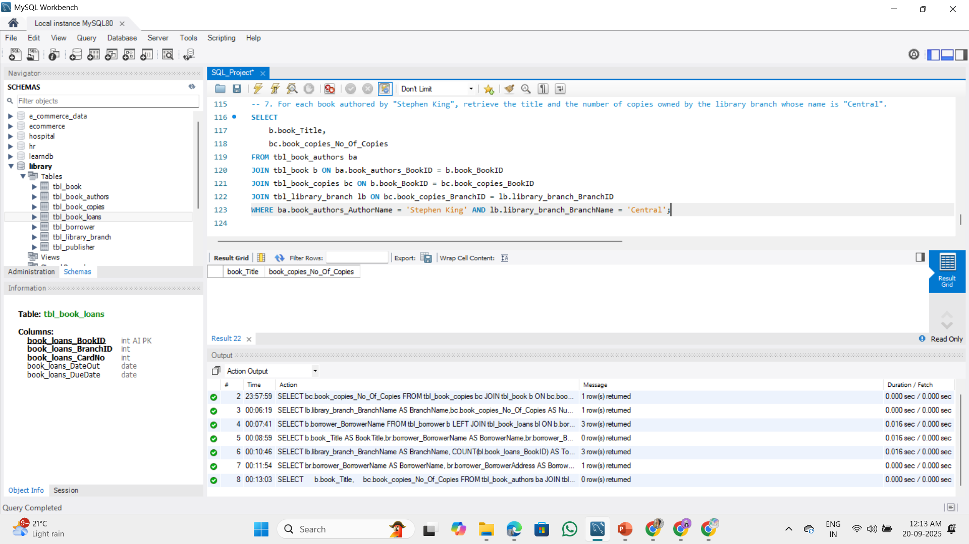
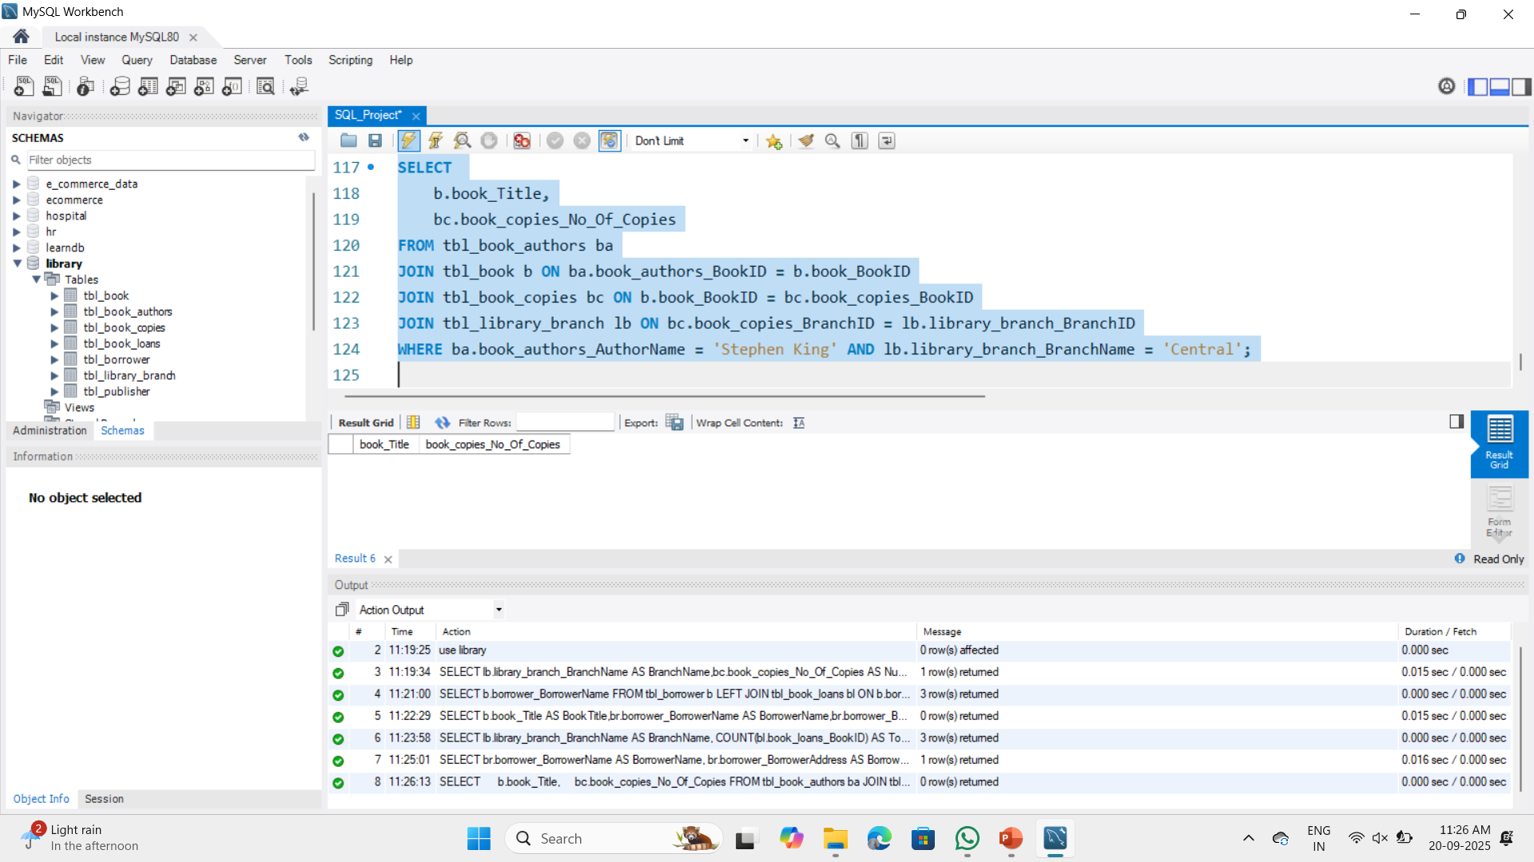
7. For each book authored by "Stephen King", retrieve the title and the number of copies owned by the library branch whose name is "Central".
Result:

Slide 15
Final business insights and recommendations:
Insights:
Sharpstown branch shows higher borrowing activity than others.
Some borrowers are inactive, while a few borrow excessively (risk of overdue).
Demand is concentrated on certain popular books/authors.
Book distribution is uneven across branches.
Recommendations:
Rebalance inventory of popular books across branches.
Engage inactive members with reminders and offers.
Set borrowing limits/alerts for high-volume borrowers.
Use data dashboards for demand tracking and future planning.

Slide 16
Conclusion (Key finding overall)
The library database project provides a systematic way to manage books, authors, publishers, borrowers, and library branches. By using relational tables with proper constraints, the system ensures accuracy and consistency of data. Through SQL queries, we can answer real-world questions such as the number of copies available at each branch, borrower activity, overdue books, and author-wise book details. This not only improves the efficiency of day-to-day operations but also supports better decision-making for library management. Overall, the project demonstrates the importance of database design and analysis in creating an organized and reliable library system.

Slide 17
Your Experience/Challenges working on SQL – Data Analysis Project.
In my SQL–Data Analysis project on a Library Management System, I designed and implemented a relational database with tables for publishers, books, authors, branches, borrowers, copies, and loans, applying primary keys, foreign keys, and referential integrity to ensure consistency. I developed queries to address real-world scenarios such as tracking book availability across branches, identifying borrowers with no or multiple checkouts, calculating the total number of books loaned per branch, and retrieving due or overdue records. Through this, I strengthened my skills in joins, grouping, aggregation, and using conditions with HAVING. Some challenges I faced included designing the schema with accurate key relationships, managing foreign key constraints during data insertion, handling date formats in queries, and avoiding errors in multi-table joins. Overall, the project gave me valuable hands-on experience in converting business requirements into efficient SQL solutions.

Slide 18

THANK YOU

